Slide 1

EE 252
Electrical Engineering Machines
UNIT 3 – Intro to Polyphase Machines
EMMANUEL ADDO
kwakuantoh@yahoo.com//0208201565; 0243225858

Slide 2
Unit 3 – Outline of Presentation
Types of three-phase AC machines (synchronous, induction, commutator)
Constructional features of 3-phase induction motors
Two types of 3-phase induction motors (squirrel cage, wound-rotor)
Principle of operation of induction motors
Speed and slip of induction motors

Slide 3
3.1: Introduction
AC machines may be either generators or motors.
Most of the motors used in industry and the home are of the alternating-current type.
Industrial motors are usually designed for three-phase operation and
Domestic motors are designed for the single-phase systems used in the home.
Unlike three-phase motors being self-starting, the single-phase motors are not self-starting and require to be wound in a special way and be fitted with special starting arrangements.

Slide 4
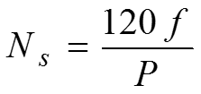
3.1: Introduction (2)
AC machines may be either generators or motors.
Most of the motors used in industry and the home are of the alternating-current type.
Industrial motors are usually designed for three-phase operation and
Domestic motors are designed for the single-phase systems used in the home.
Unlike three-phase motors being self-starting, the single-phase motors are not self-starting and require to be wound in a special way and be fitted with special starting arrangements.
The speed an AC motor depends on the number of poles and the frequency of the supply system.
The relationship between speed, number of poles and frequency is given by

Slide 5
3.1: Introduction (3)
The speed of some industrial motors is changed either by
  a)pole-changing in which the motor stator windings are switched to give different number of poles.
  b)frequency change through frequency changers.
The AC motor, like DC motors, consists of a stationary part (the stator), and a rotating part (the rotor), on which are wound a set of current-carrying coils that are both excited.
The stator is built up of laminated steel plates.
Laminations are used, rather than a solid core, to minimize the eddy-current losses associated with AC magnetic circuits.
The rotating part, the rotor, is also made up of laminated plates mounted on the motor shaft
The rotor can be of the squirrel cage or wound-rotor design.

Slide 6
3.2: Types of 3-phase motors by construction
By construction, AC motors may be of the synchronous, induction or commutator type.
(1) Synchronous: If one winding is made to carry a steady direct current (DC) and the other an alternating current (AC) whose frequency equals the angular velocity of the rotating part, the device is a synchronous machine.
(2) Induction: If one winding is energised by an AC, and the other is short-circuited, the device is called an induction machine.
(3) Commutator: If one winding carries a steady DC, and the other carries a current that reverses each half revolution of the rotor, a non-zero average torque will result. The reversal is accompanied by a commutator

Slide 7
3.3: Constructional features of 3-phase induction motors
Because of its (i) simple, (ii) rugged and (iii) cheap construction as well as (iv) good operating characteristics, induction motors suit most industrial requirements and applications.
In conventional induction motors, the stator is connected to AC supply, and the rotor winding is short-circuited for many applications, or it may be closed through external resistances.
Current is induced in the rotor winding by transformer action or electromagnetic induction from the stator.
Because of this, the stator is sometimes referred to as the primary and the rotor referred to as the secondary of the induction motor.
The poly-phase induction motor requires no means for its excitation other than the AC line.

Slide 8
3.3: Constructional features of 3-phase induction motors (2)
The induction motor runs below synchronous speed and is known as an asynchronous machine
The stator core has no salient or projecting poles, and is built of slotted laminations that are supported in a stator frame of cast iron or fabricated steel plate.
Laminations are used rather than a solid core, to minimize the eddy current losses associated with AC magnetic circuits.
The poly-phase induction motor falls into two general categories, depending on the kind of rotor used:
  a)squirrel-cage rotor
  b)the wound-rotor.

Slide 9
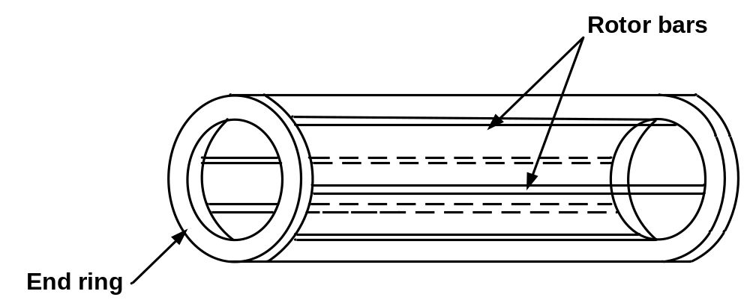
3.3.1: Squirrel cage induction motors
The rotor of a squirrel-cage induction motor is also laminated and slotted to contain the rotor windings.
At each end of the rotor, the rotor conductors are all short-circuited by continuous end rings.
In the larger motors, the rotor bars, instead of being cast, are wedged into the rotor slots and are then welded securely to the end rings.

Slide 10
3.3.1: Squirrel cage induction motors (2)
Squirrel-cage rotor bars are not always placed parallel to the motor shaft but are sometimes skewed.
This results in a more uniform torque and also reduces the magnetic humming noise when the motor is running.

Slide 11
3.3.2: Wound-rotor (or slip ring) induction motors
The wound-rotor or slip-ring motor has a three-phase stator winding similar to that of the squirrel-cage motor.
The wound-rotor motors differ from the squirrel-cage motor in the rotor construction.
The rotor phase windings are star-connected and terminate in slip-rings mounted on the rotor shaft.
Wound-rotor induction motors are thus called slip-ring motors.
The rotor winding is not connected to a supply, the slip rings and brushes merely providing a means of connecting an external variable-speed-control resistance into the rotor circuit, particularly for starting.
During normal running, the slip rings are short-circuited.
Thus the principle of operation is the same for both squirrel-cage and wound-rotor types of induction machine

Slide 12
3.4: Principle of operation of 3-phase induction motors
When the stator winding is energized from a three-phase supply, a rotating magnetic field is established which rotates at synchronous speed.
As the rotating field sweeps across the shorted rotor conductors, an emf is induced in these rotor conductors , and current flows in the shorted rotor windings, and thus flux is produced in the rotor windings.
The induced flux in the rotor interacts with the inducing stator magnetic field , and thus force and hence torque is exerted upon the rotor.
There is no electrical connection between the stator and the rotor. The motor action is due to rotor induced voltages, and so the motor is often referred to as induction motor.
If the developed torque is great enough to overcome the resisting torque of the load, the motor will accelerate.

Slide 13
3.5: Speed and slip of 3-phase induction motors
An induction motor cannot run at synchronous speed, that is, the speed at which the stator magnetic field rotates.
If it were, there would be no relative movement between the rotor conductors and the field, and hence no emf would be induced in the rotor winding, no rotor current would flow and therefore there would be no torque developed.
As such, the rotor speed even at no-load must be slightly less than synchronous speed in order that current may be induced in the rotor, thereby producing a torque.
This difference between the actual rotor speed and the synchronous speed is called the slip of the motor, and is of the order of 5% of the synchronous speed of standard motors at full-load

Slide 14
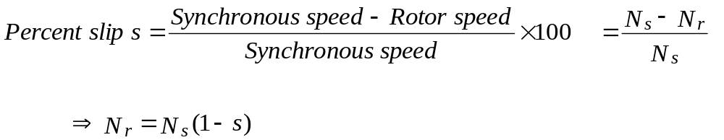
3.5: Speed and slip of 3-phase induction motors (2)
Thus:
The slip is more commonly expressed as percent of the synchronous speed.
The per unit or percent slip is calculated as follows:

Slide 15
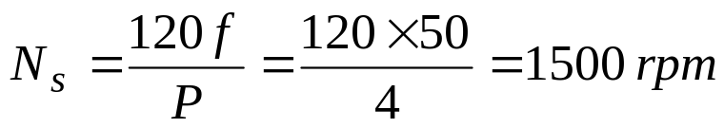

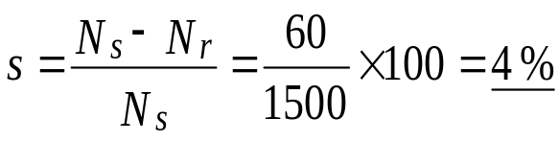
3.6: Example 1 & Solution 3.1
A 4-pole 50 Hz squirrel-cage motor has full-load speed of 1440 rpm. What is the percent slip at full-load?
SOLUTION 3.1:
The synchronous speed is
The slip (in rpm):
The slip (in %):

Slide 16

Thank You – End of Unit 3
For any concerns, please contact
elearning@knust.edu.gh
elearningknust@gmail.com
0322 191132

